Slide 1

SA3 Final Project
Milestone 2

Slide 2

HandShake

Slide 3

Fixing bugs
Polishing code
Fixing bugs
Polishing code
Finishing features
Fixing bugs
Notes:
this week was mostly focused on fixing bugs and polishing the code, as well as finishing up some features

Slide 4
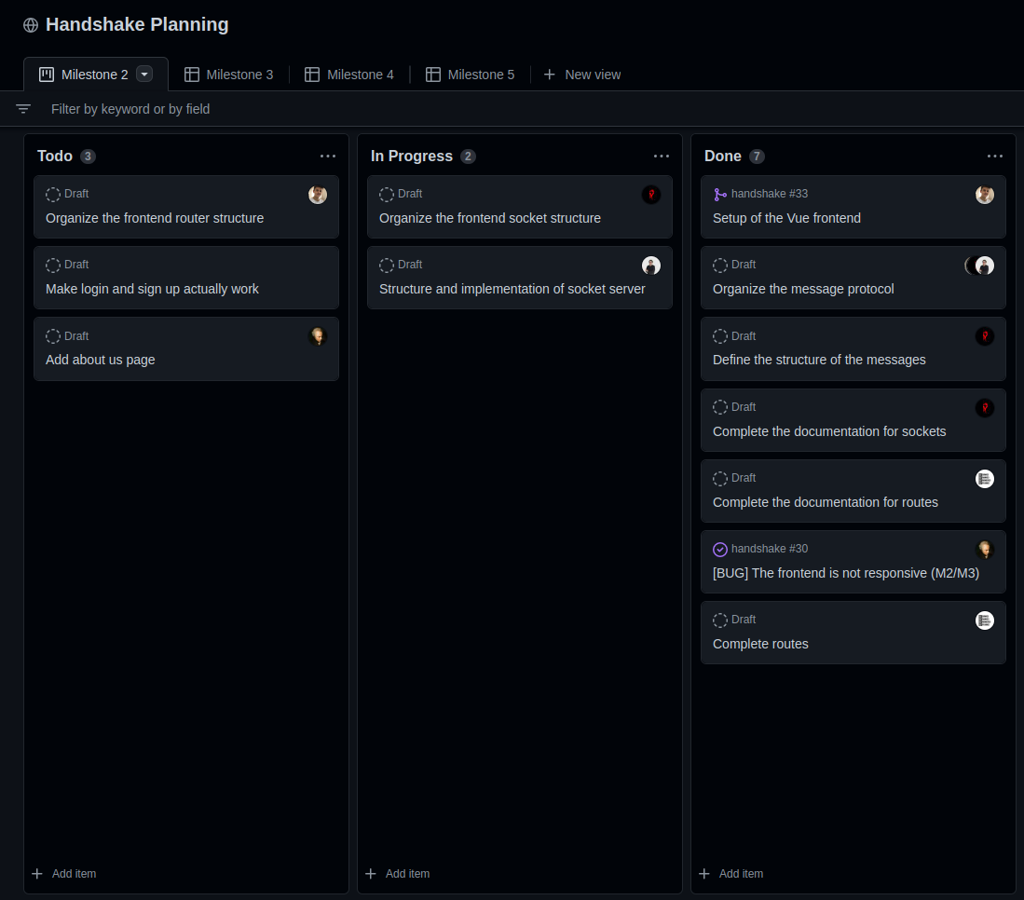
Notes:
and by the way, we set up a github projects page for the next milestones

Slide 5
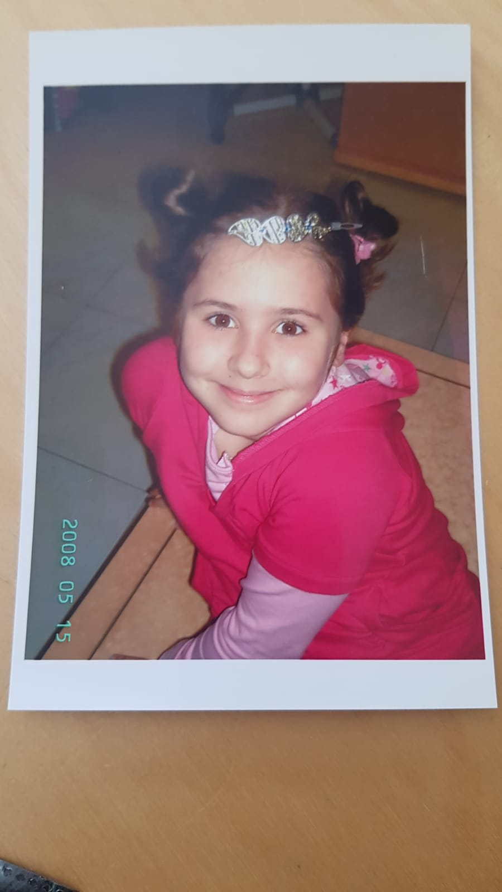
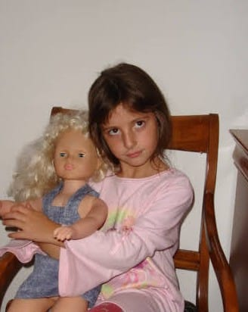
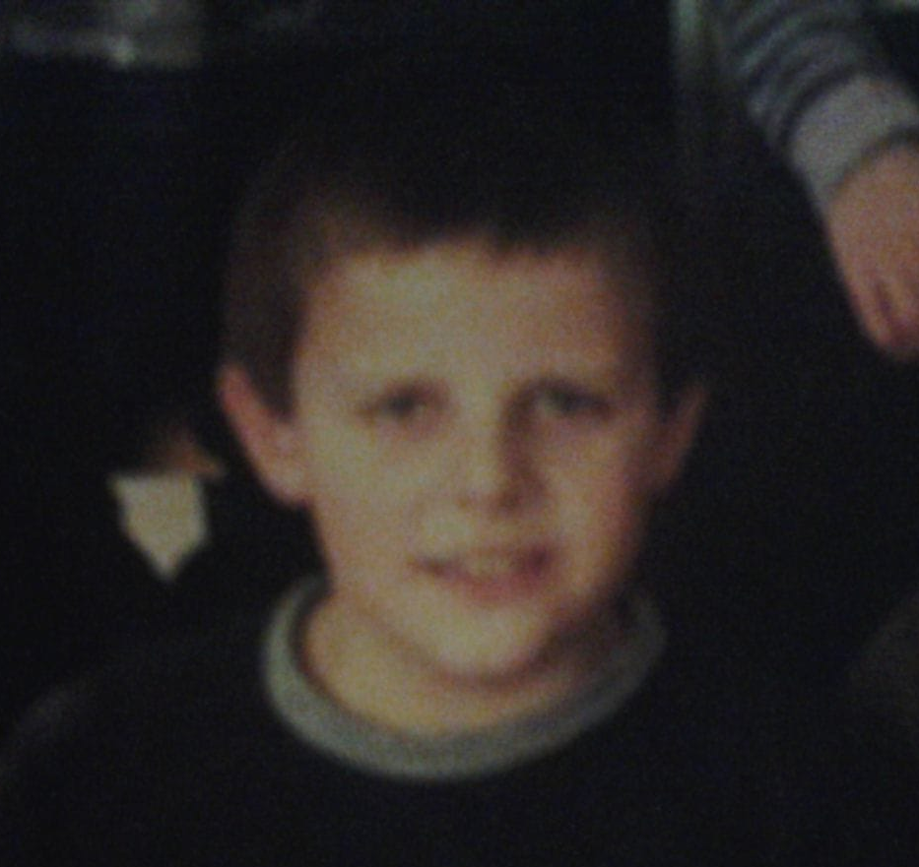

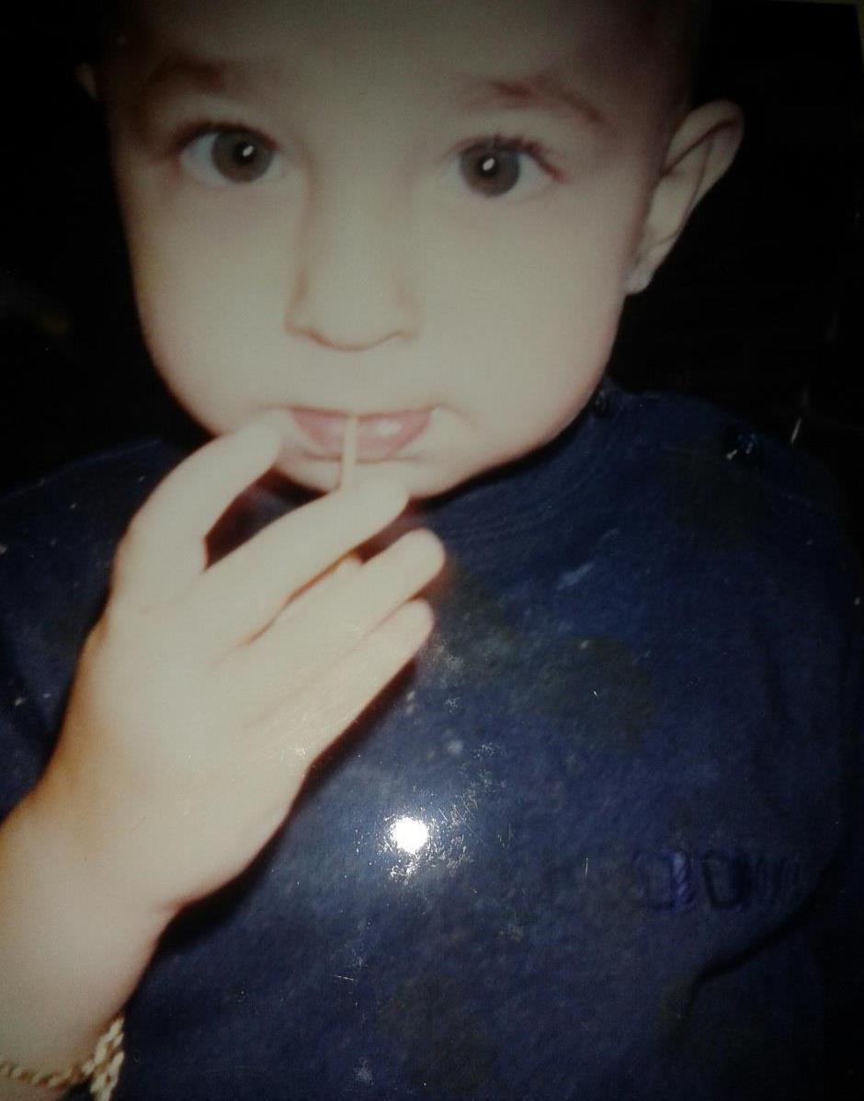
Roles
CSS + About
Frontend + Backend
Setup + Frontend + Tester
Frontend
Backend + Customer + Tester

Slide 6

layout
Notes:
first of all, we had to decide, what should the website look like

Slide 7
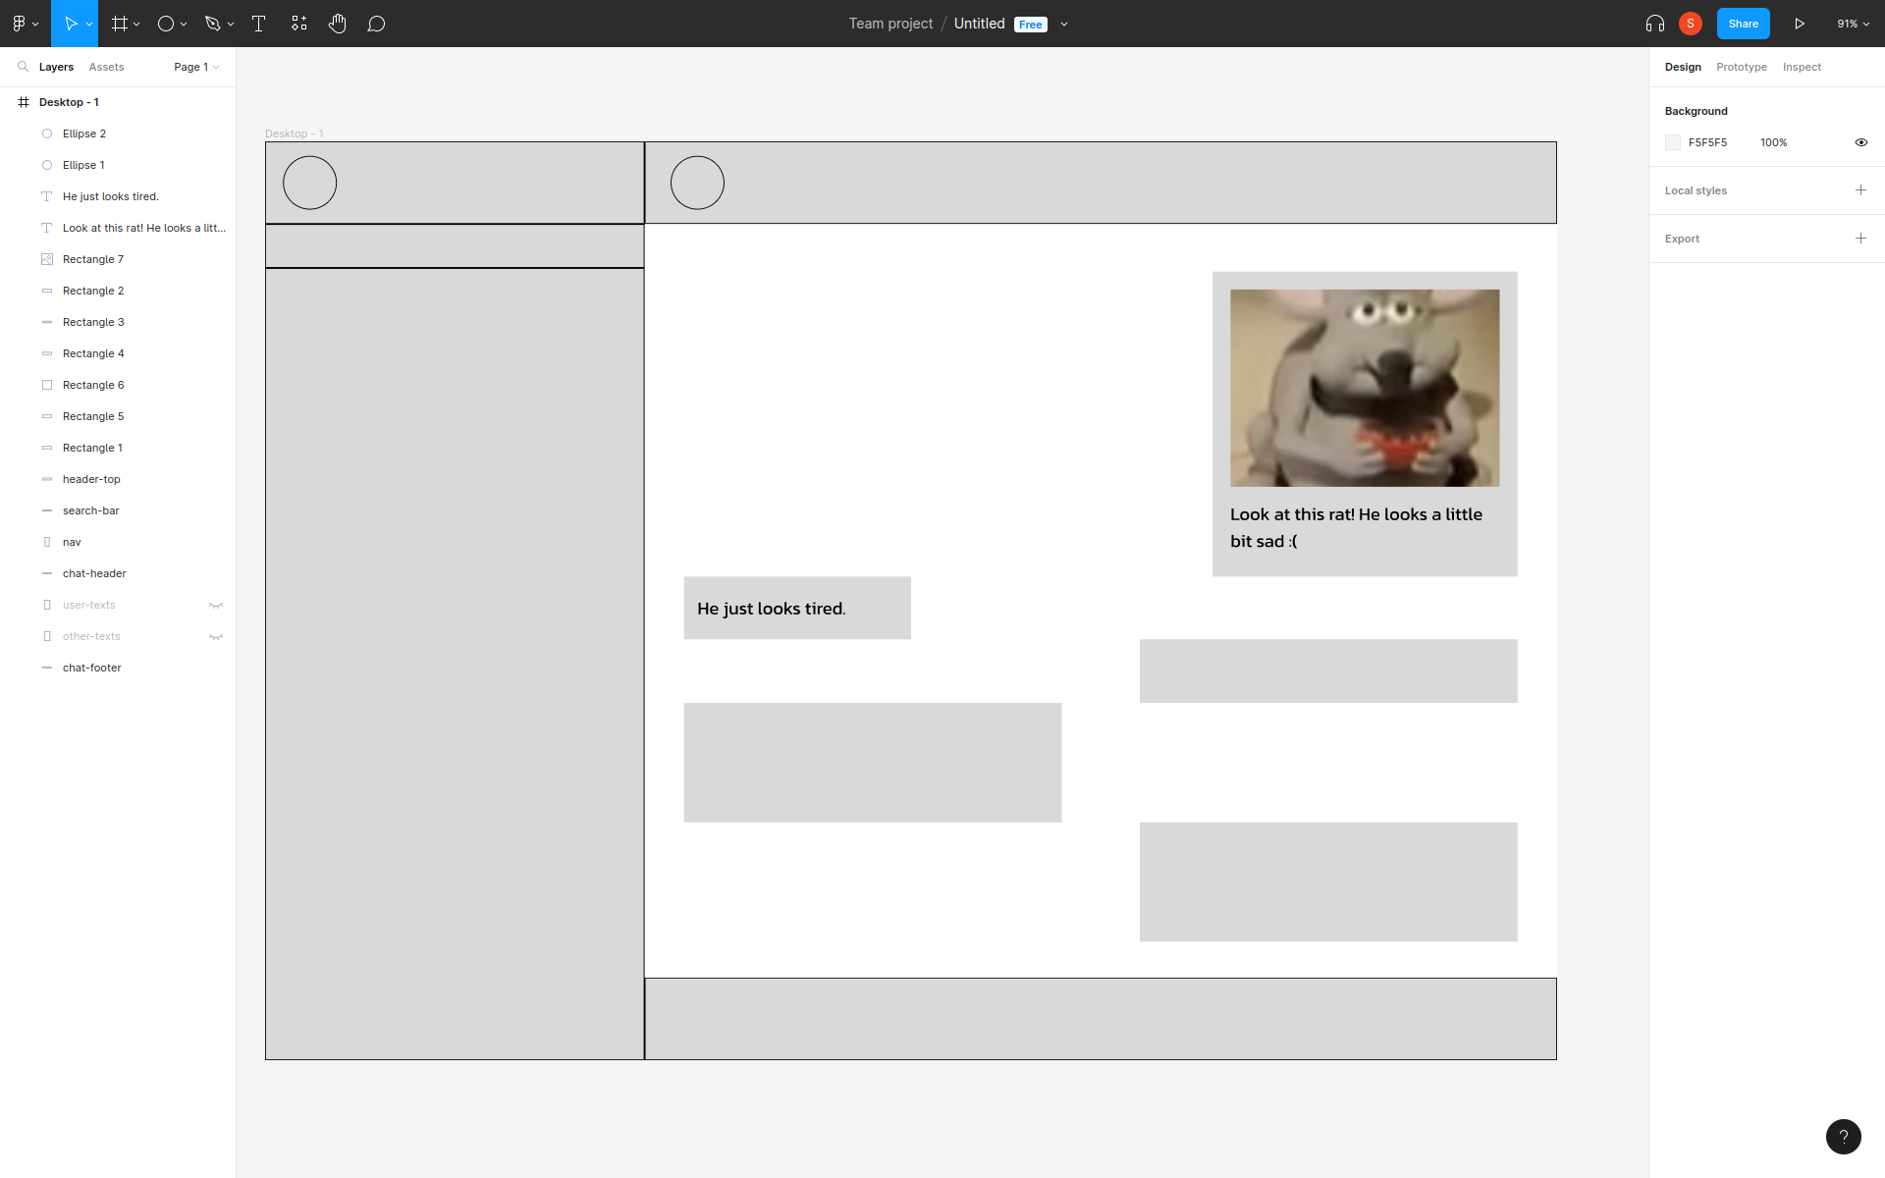
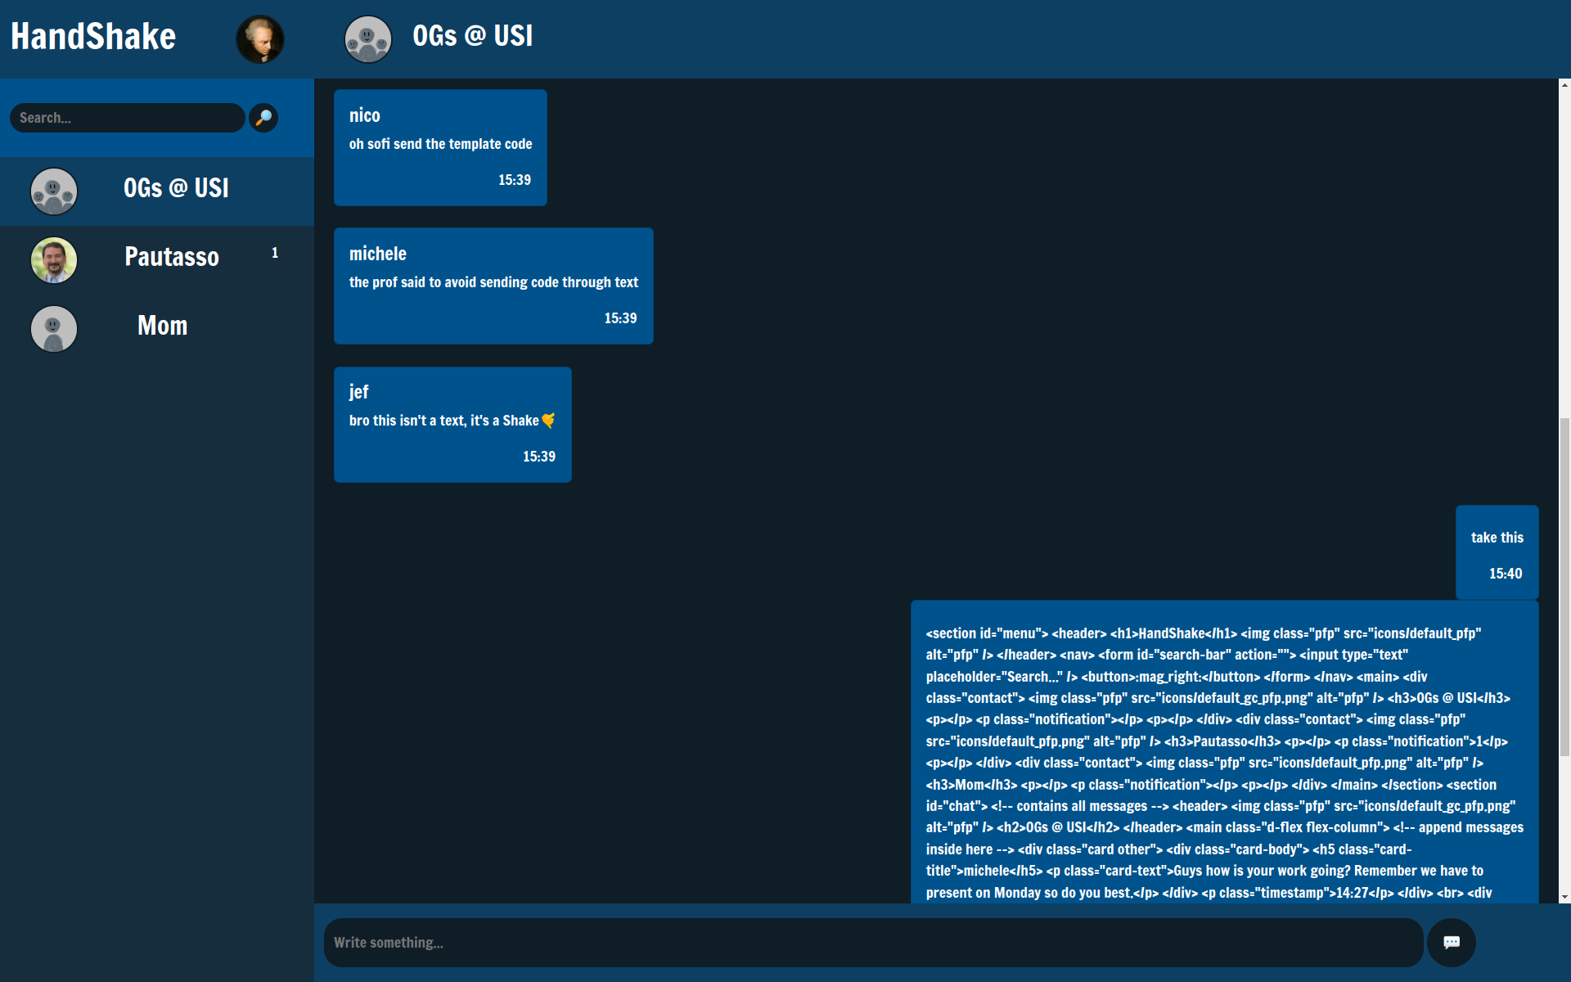
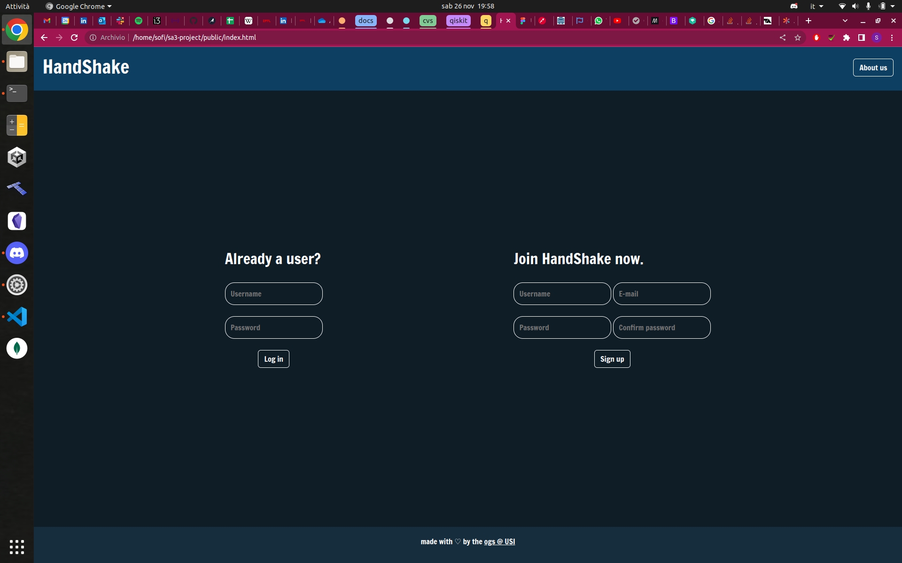
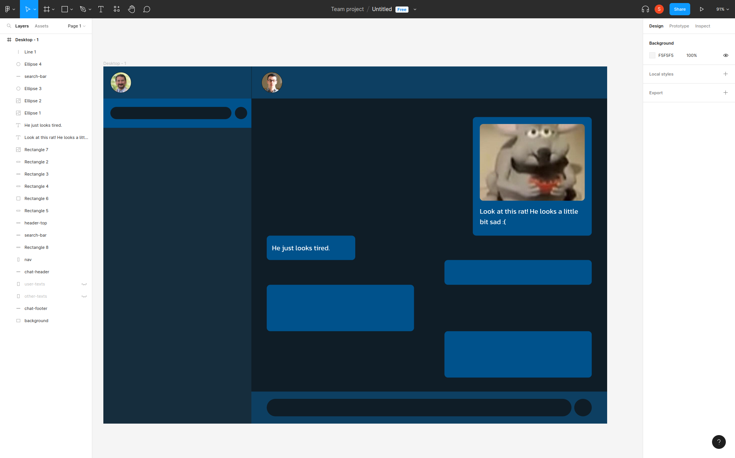
Notes:
so last time with the fronted we left off with our figma sketch, the chat draft, the login page and the themes goal
what happened this week?

Slide 8


Notes:
so, something i forgot to mention last week, was that for the layout, we were using bootstrap, but since it was something new, i made the most of the layout with css, and then sprinkled some bootstrap on top of it

Slide 9
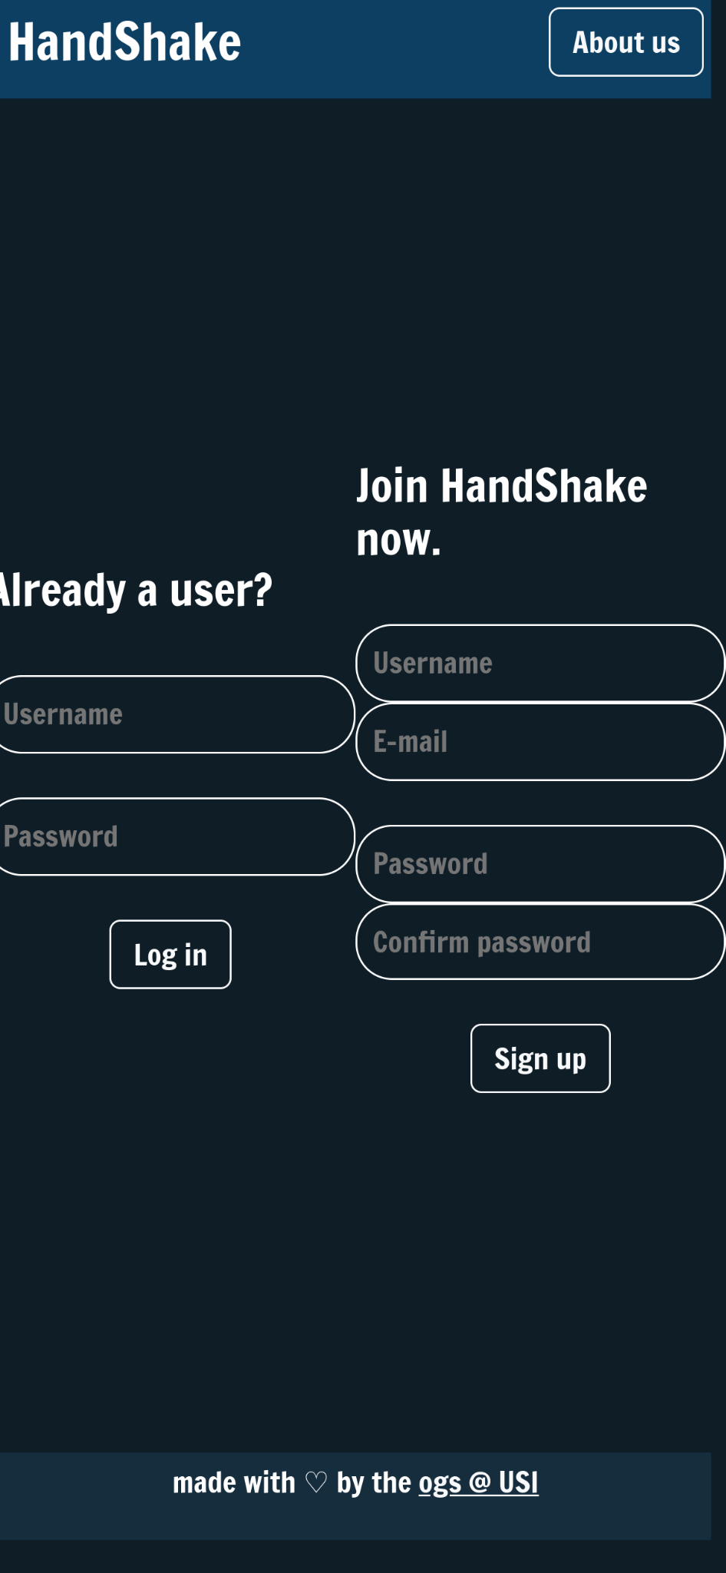
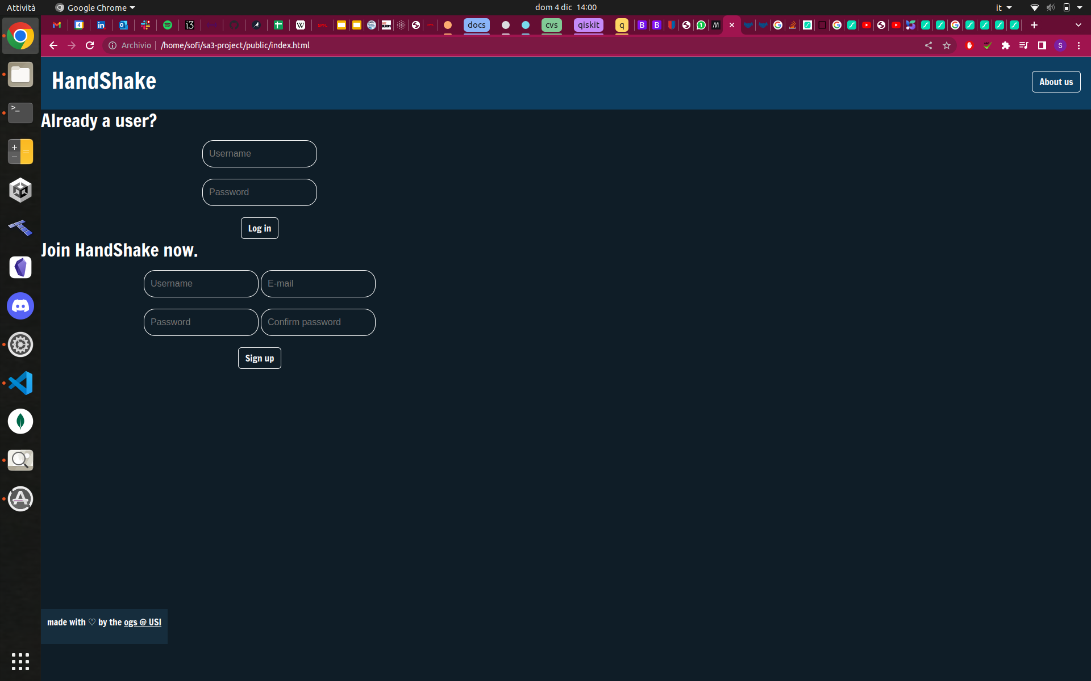
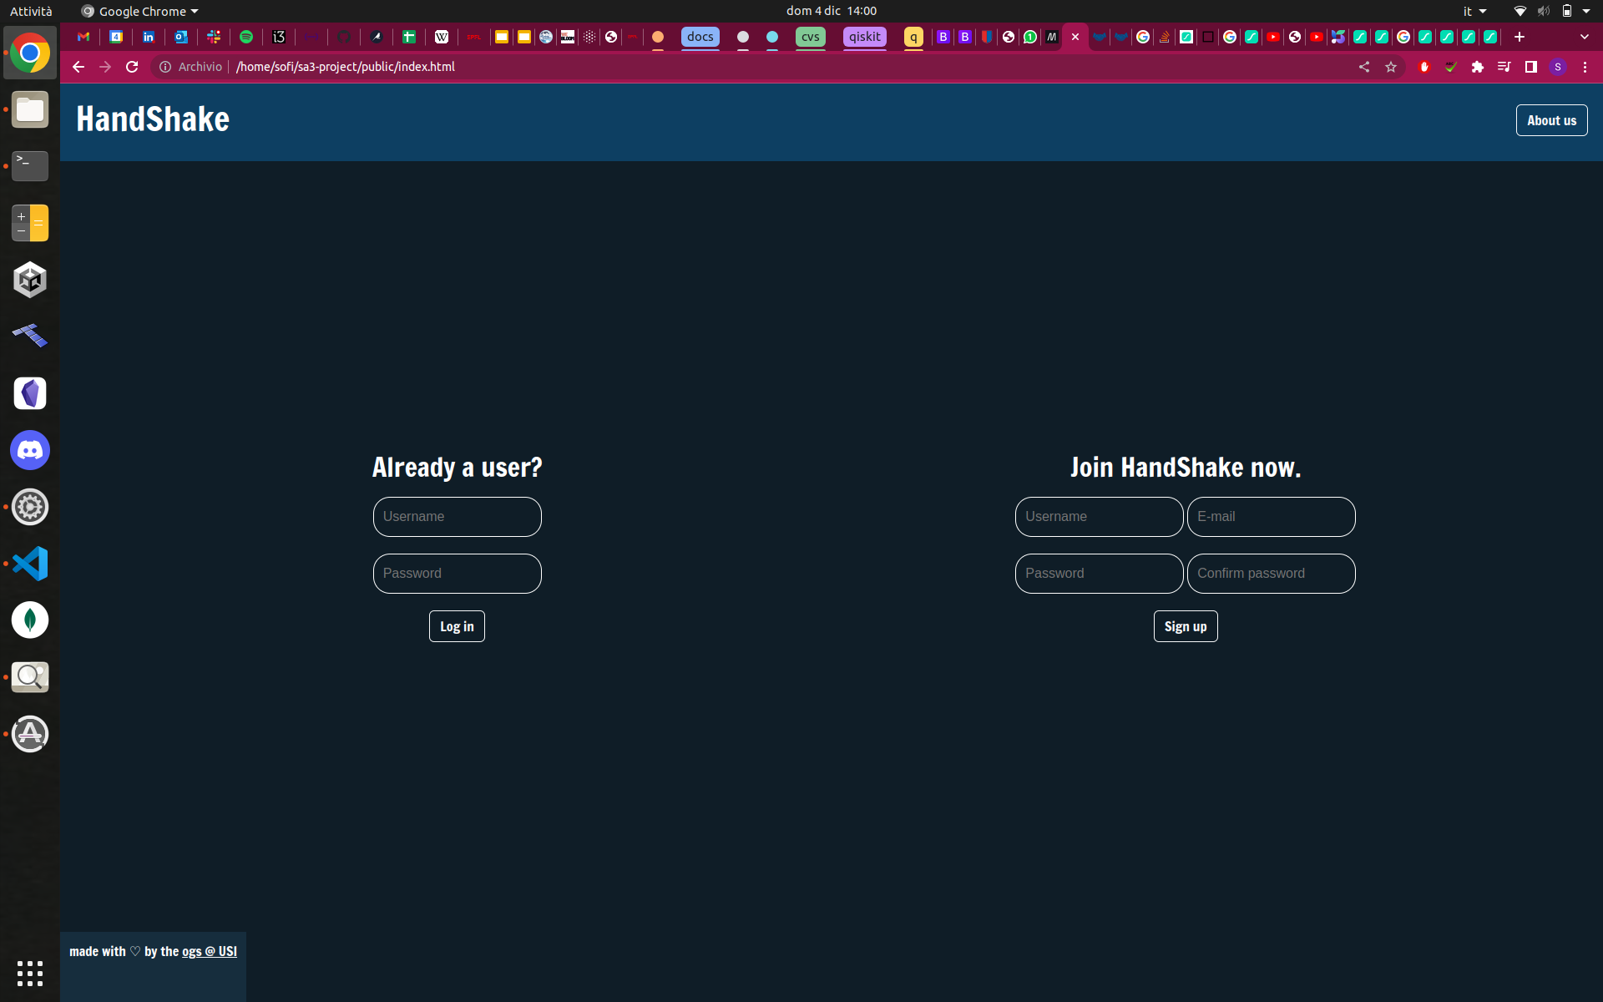
Notes:
as you can imagine, this inconsistency led to some issues

Slide 10
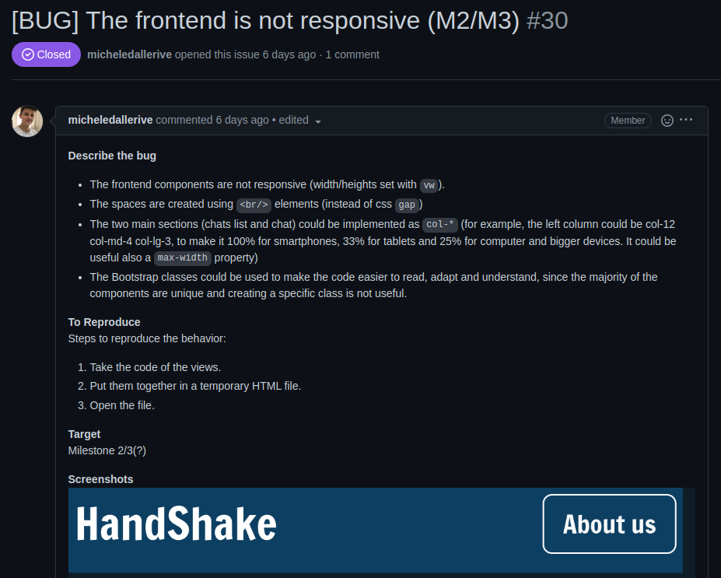

Slide 11
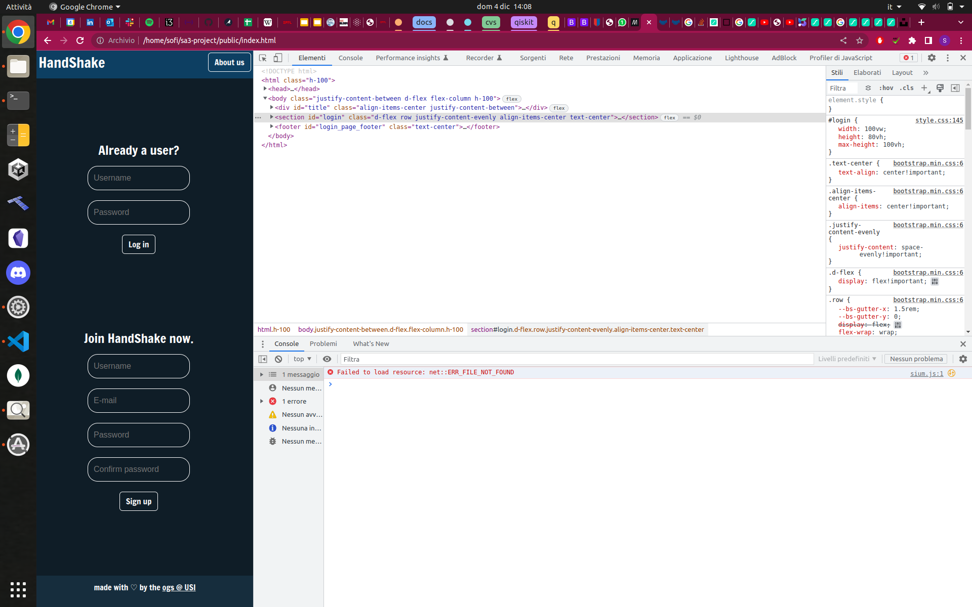
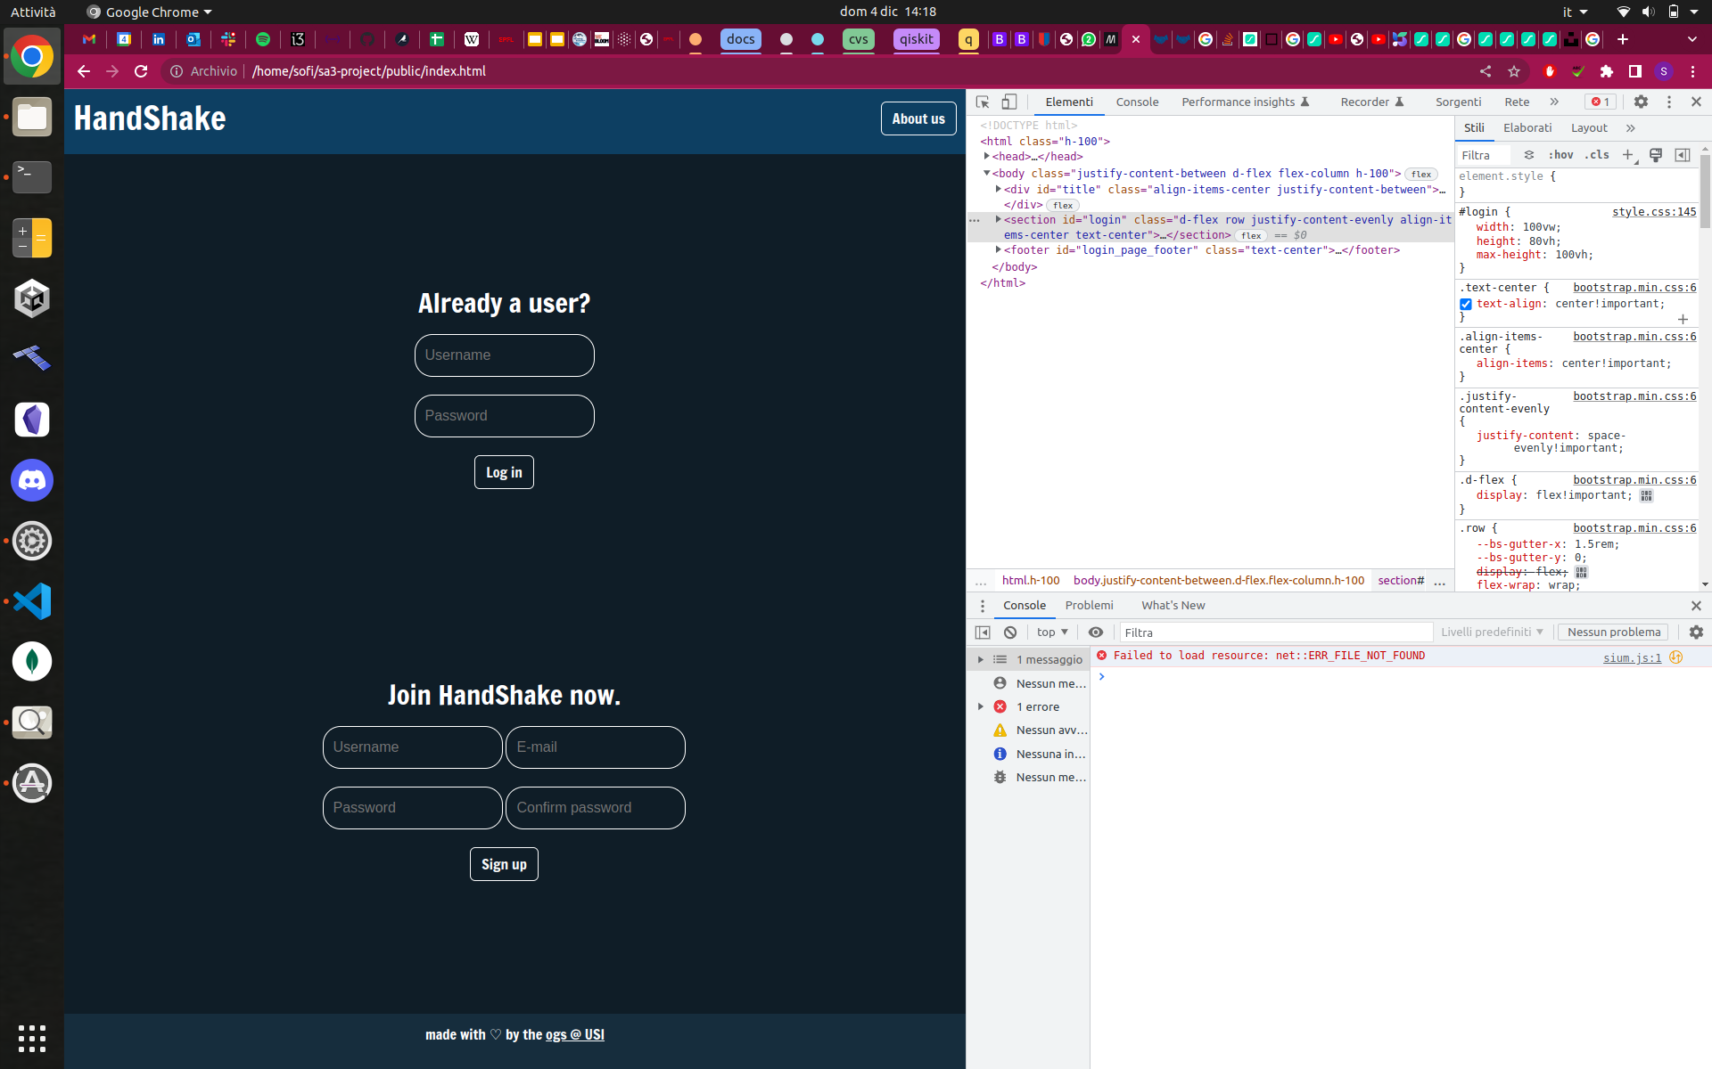
Notes:
but we solved everything right away! and now it looks better

Slide 12

About us / Homepage
Notes:
but that’s not all! we also added an about us page, so users can learn more about HandShake. but before i talk about this, and i mean, there’s not much to talk about anyway, i’d like to introduce a new interesting thing i’ve been using this week, and last week as well

Slide 13

Notes:
remember the iconic handshake animation?

Slide 14



Slide 15
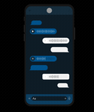


Notes:
so on lottie you can find a bunch of free animations like the ones you see in this screen,

Slide 16
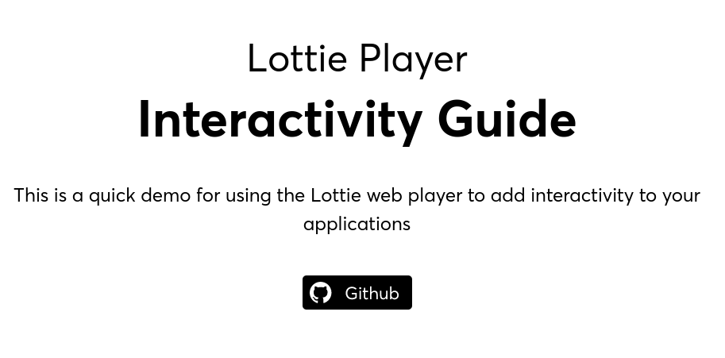
Notes:
however, lottie has an interesting library that you can use to make the animations interactive on websites and applications.

Slide 17

Notes:
for example, take a look at this animation. it is made of 3 different animations chained together and the chain reaction starts when you click on the pigeon

Slide 18

frontend

Slide 19
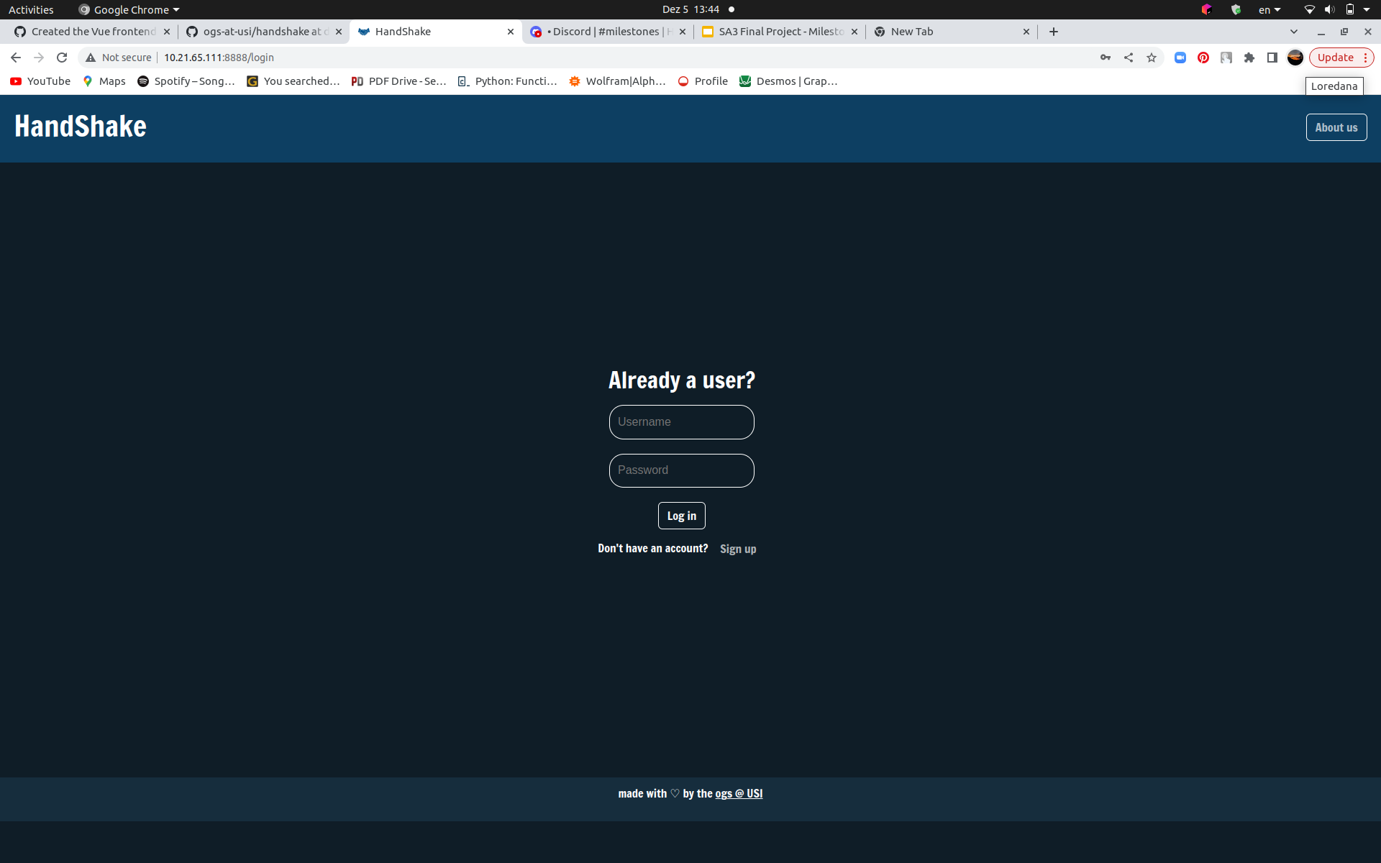
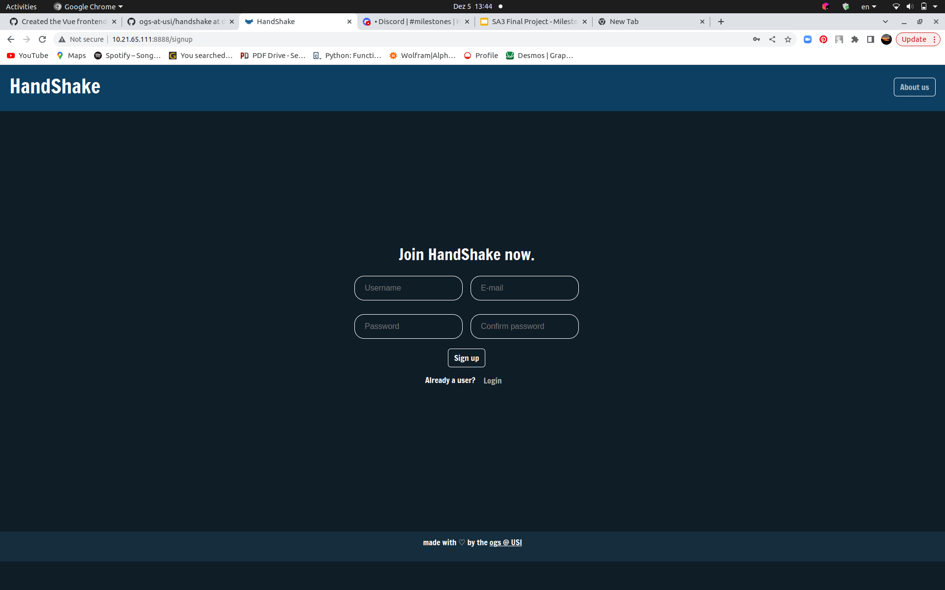
Frontend #Vue
Created Login and SignUp

Slide 20
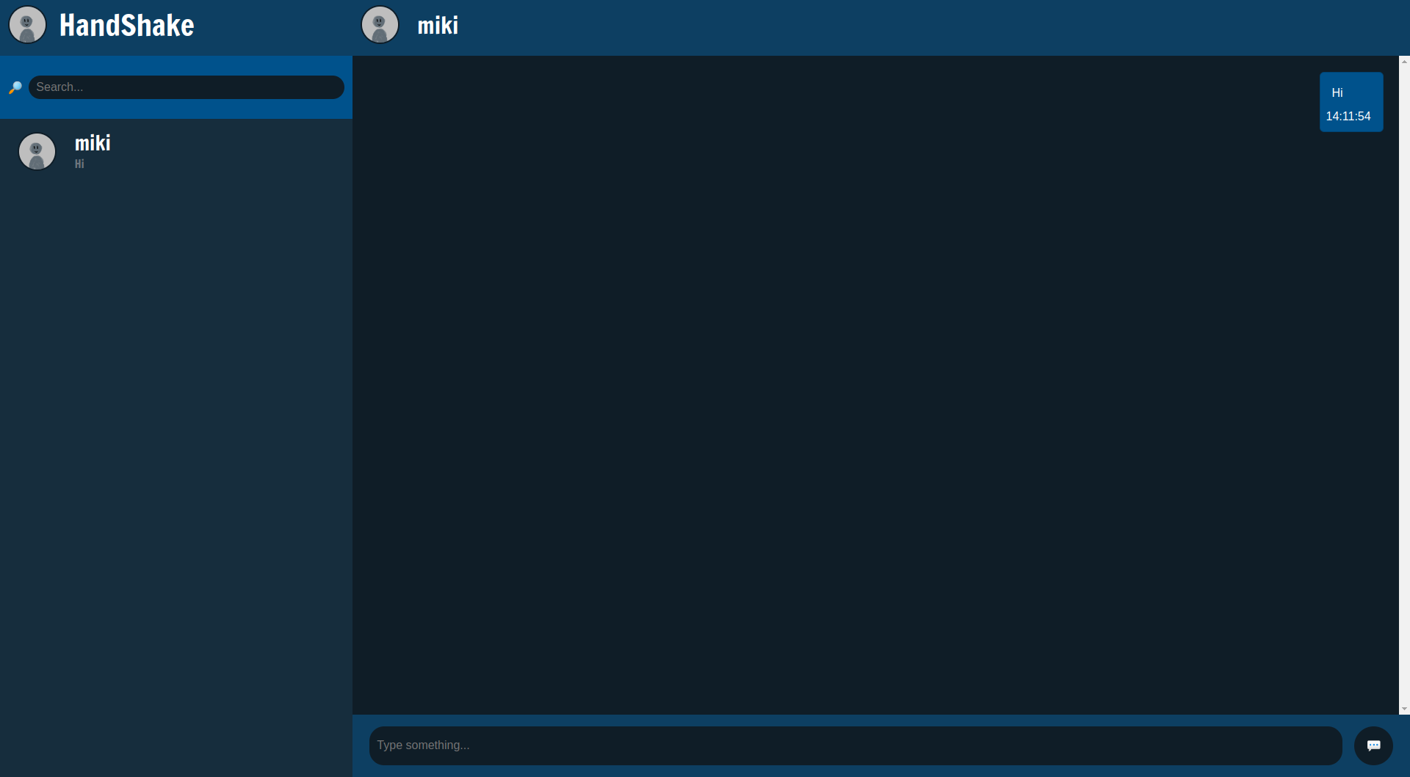
Handled the exchange of messages

Slide 21
Handled the exchange of messages
Requests validation

Slide 22
Handled the exchange of messages
Requests validation
Check if chat exists

Slide 23
Handled the exchange of messages
Requests validation
Check if chat exists
Create messages

Slide 24

chat features

Slide 25

Automatic scroll down

Slide 26
Automatic scroll down
Focus on the chat box

Slide 27
Automatic scroll down
Focus on the chat box
Timestamps

Slide 28
Automatic scroll down
Focus on the chat box
Timestamps
Prevent empty messages

Slide 29
Automatic scroll down
Focus on the chat box
Timestamps
Prevent empty messages
Messages on the side of the sender

Slide 30
Automatic scroll down
Focus on the chat box
Timestamps
Prevent empty messages
Messages on the side of the sender
Fixed bugs

Slide 31

Message protocol
Notes:
Defining the message protocol

Slide 32
Message exchange dilemma: HTTP / socket
Notes:
Planning to formally define message protocol requirements to obtain a real-time message application:
- Message exchange dilemma: HTTP / socket
- Socket as passive state updates propagation for clients
- Diving HTTP routes and socket
- Prototyping

Slide 33
Message exchange dilemma: HTTP / socket
Socket as passive state updates propagation for clients
Notes:
Planning to formally define message protocol requirements to obtain a real-time message application:
- Message exchange dilemma: HTTP / socket
- Socket as passive state updates propagation for clients
- Diving HTTP routes and socket
- Prototyping

Slide 34
Message exchange dilemma: HTTP / socket
Socket as passive state updates propagation for clients
Diving HTTP routes and socket
Notes:
Planning to formally define message protocol requirements to obtain a real-time message application:
- Message exchange dilemma: HTTP / socket
- Socket as passive state updates propagation for clients
- Diving HTTP routes and socket
- Prototyping

Slide 35
Message exchange dilemma: HTTP / socket
Socket as passive state updates propagation for clients
Diving HTTP routes and socket
Prototyping
Notes:
Planning to formally define message protocol requirements to obtain a real-time message application:
- Message exchange dilemma: HTTP / socket
- Socket as passive state updates propagation for clients
- Diving HTTP routes and socket
- Prototyping

Slide 36

UML

Slide 37
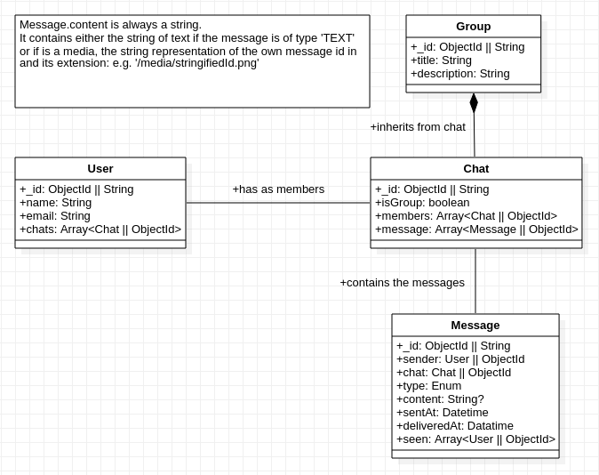
Notes:
Creating the UML scheme for the dataclasses used in client-server message exchanging in JSON format.

Slide 38

Vue.js Menu
app component

Slide 40
chat contact selection

Slide 41
chat contact selection
@click.native

Slide 42
chat contact selection
@click.native
propagation of the event to the main view AppContainer

Slide 43

VUE setup & development

Slide 44

Setup the Vue app
Automatic build in public folder to serve it from Express.

Slide 45
Quality check tools
Setup ESLint and Prettier to have a consistent code style.
Added Github action to check Vue code style.

Slide 46
Vuex store to handle the user login state.
The global store keeps track if the user is logged in
The app is accessible only with a successful login
Future feature: Persistent login

Slide 47
Setup Axios
Installed Axios in the Vue app
Created middleware to automatically refresh token.

Slide 48
Api client and + custom Vue plugin
Implemented the methods to interact with the HTTP API.

Slide 49
Vue components development
Took care of advanced Vue topics to improve the components code.

Slide 50
Dynamic user search feature
Created the app search bar to find new users to create a chat with.
Automatic users list update based on the server’s response.

Slide 51
Pagination
Created a limit in message length with a “Show more” link
Prevent long wait time to display big messages.

Slide 52
Bugs + Details
Took care of crashy bugs both in client and server code.

Slide 53

routes

Slide 54
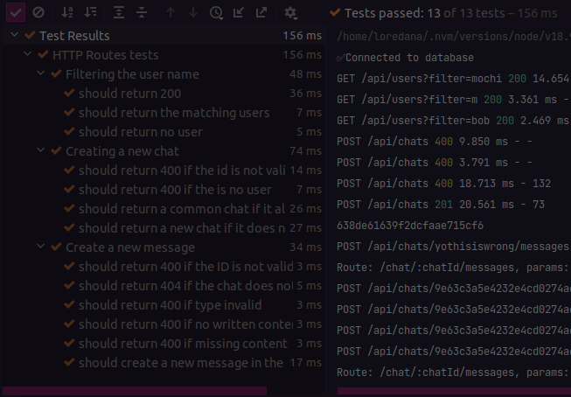
New routes

Slide 55
New routes
Polished code

Slide 56
New routes
Polished code
Full coverage testing

Slide 57

backend - socket

Slide 58


Slide 59
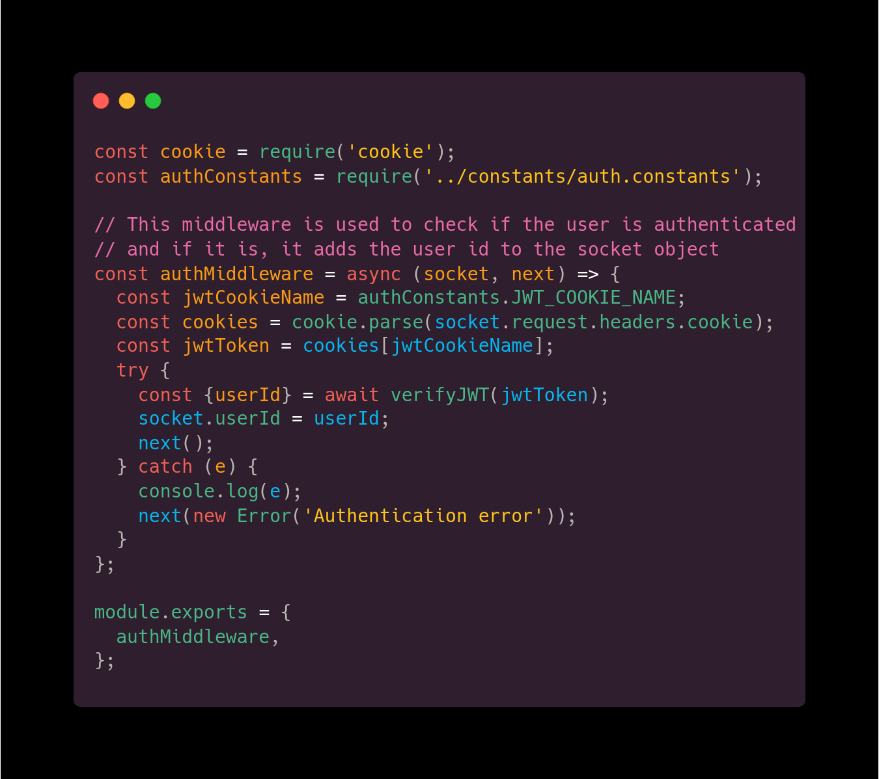
getChats(userId)
Middleware Authentication

Slide 60

Documentation

Slide 61
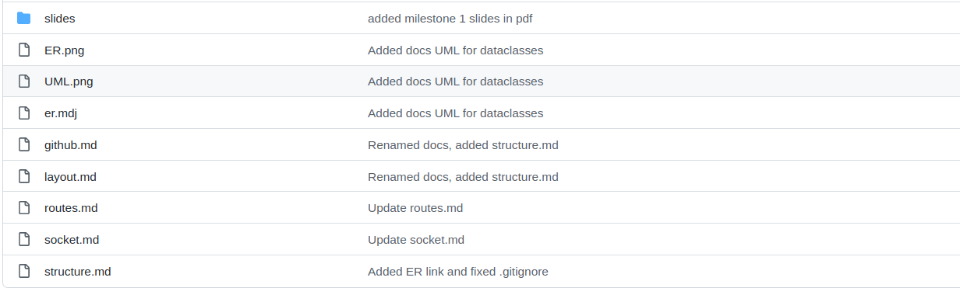
getChats(userId)
Developer Guide

Slide 62
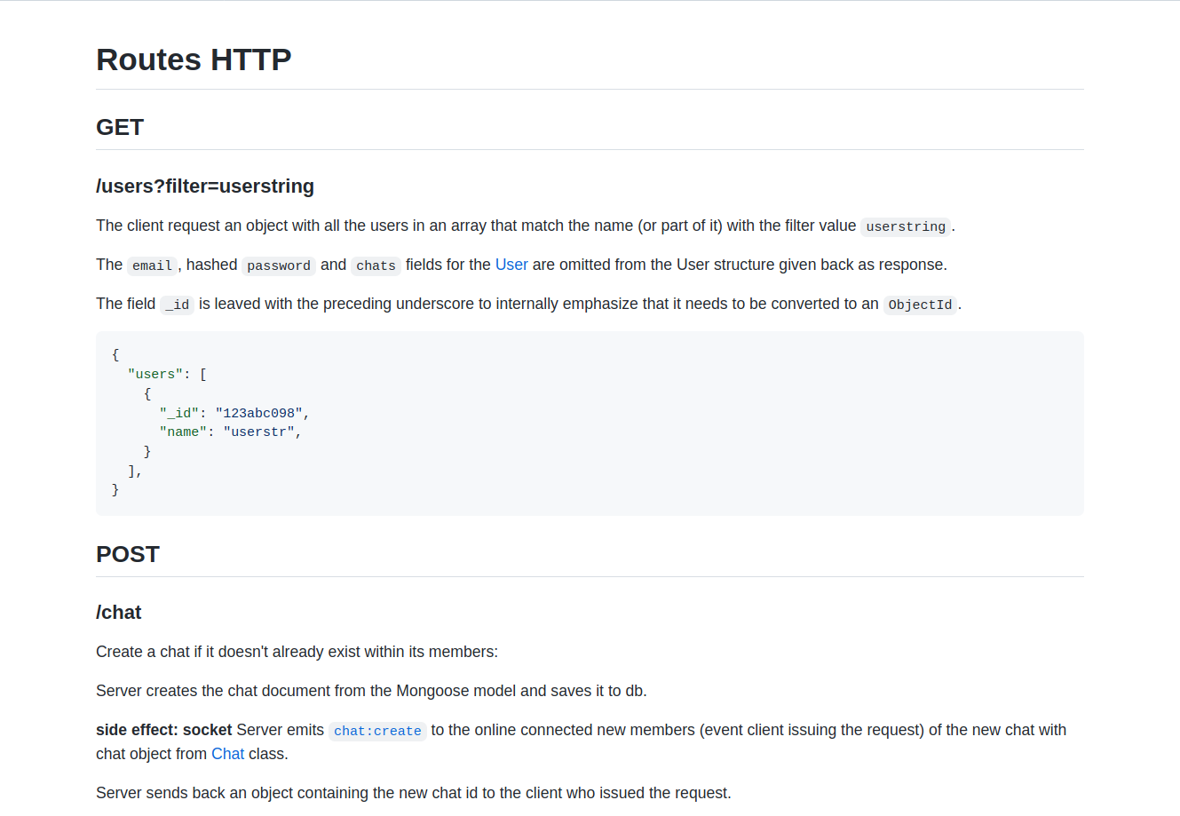
getChats(userId)

Slide 63

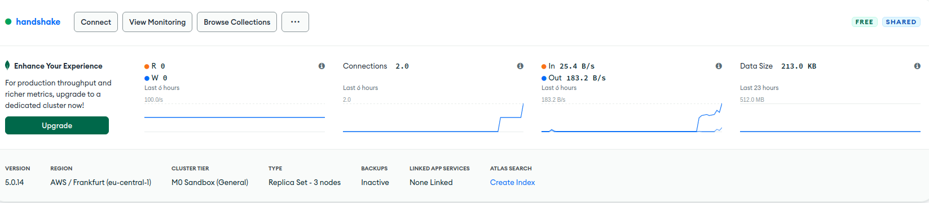

Slide 64








Tools

Slide 65

Join us!
10.21.65.111:8888

Slide 66





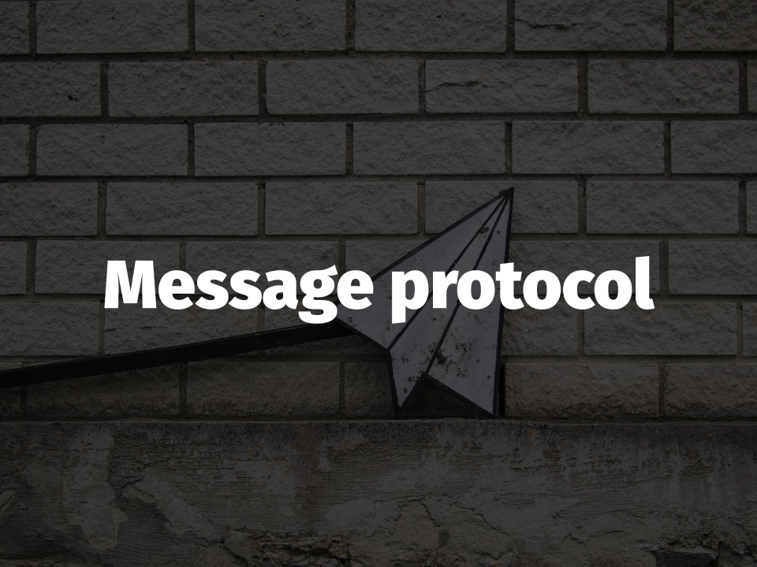
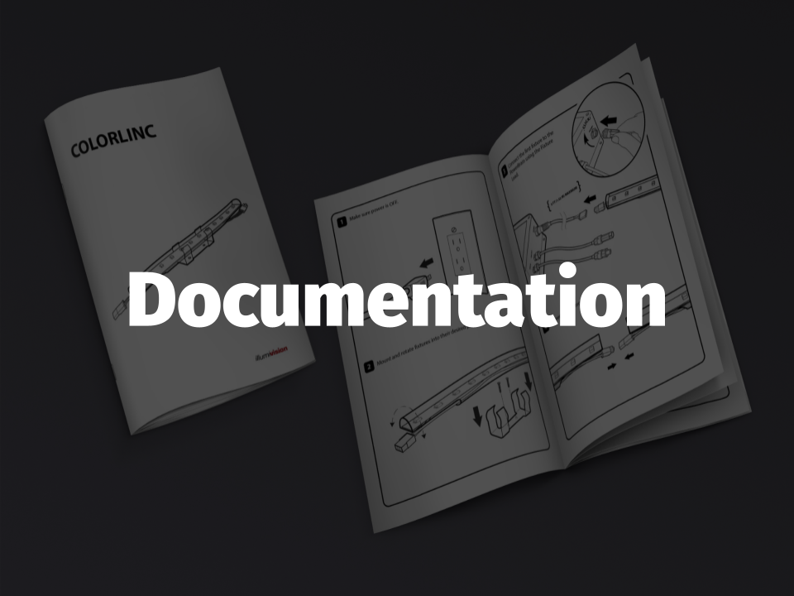



Thank you!
Dalle Rive Michele
d’Atri Sofia
De Filippo Loredana
Jeferson
Tafta Nicolò
See you at the next milestone!

